Slide 1
MINOR PROJECT
Image Captioning Using VGG16 with Bahdanau Attention and LSTM: An Advanced Approach for Generating Descriptive Text

Slide 2
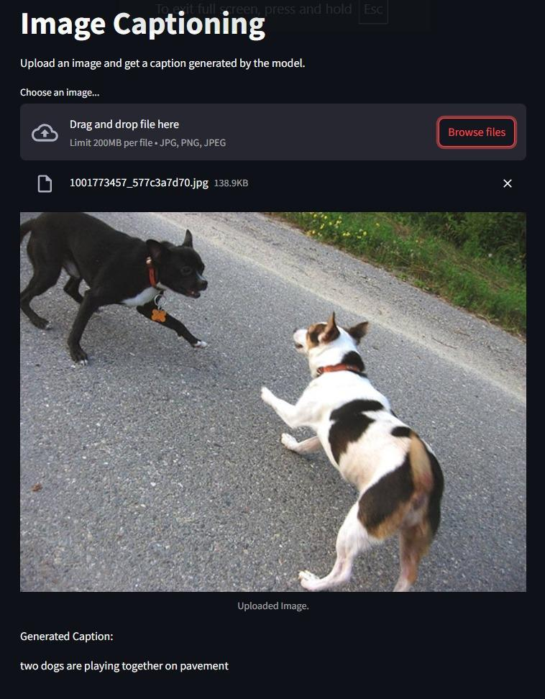
INTRODUCTION
1. Image captioning combines computer vision and natural language processing.
2. Generates textual descriptions for images.
3. Applications: Assistive technology, multimedia content organization, and search engines.
4. Approach: Use VGG16 for image feature extraction and Bahdanau Attention for precise captioning.

Slide 3
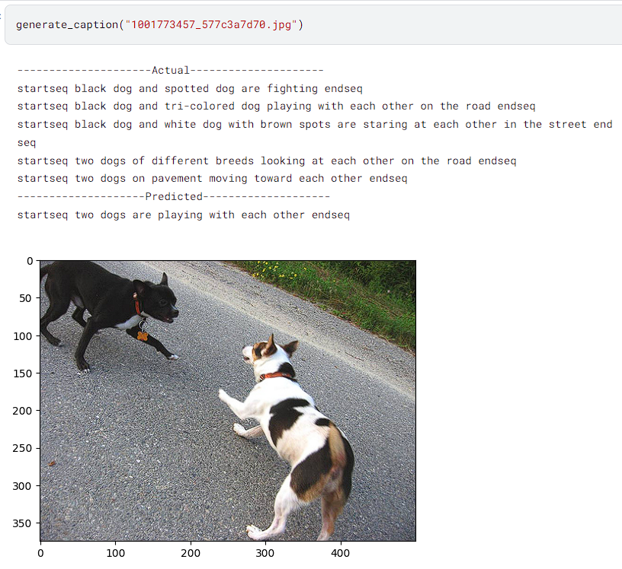
OBJECTIVE
Build a system to generate accurate, context-aware captions for images.
Combine CNNs (VGG16) for visual features and RNNs (LSTMs) with attention for natural language generation.
Address challenges of capturing fine-grained details and relationships in images.

Slide 4
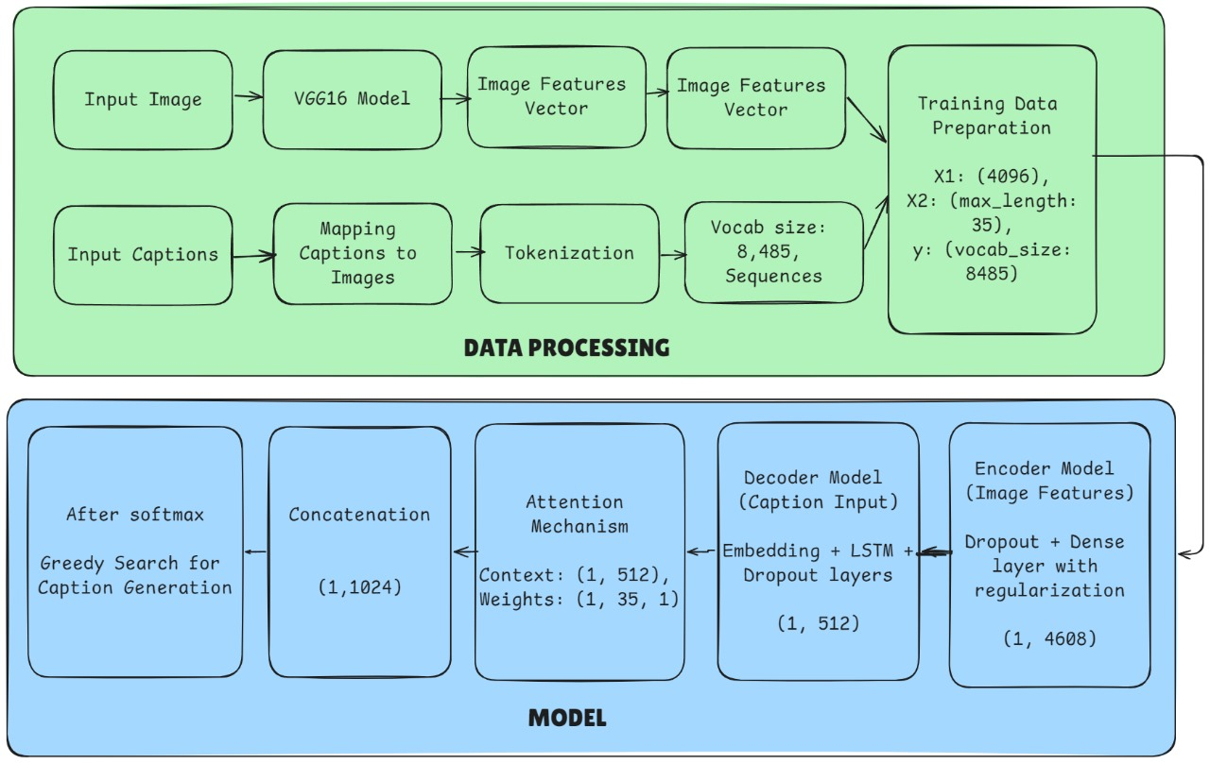
FLOWCHART

Slide 5
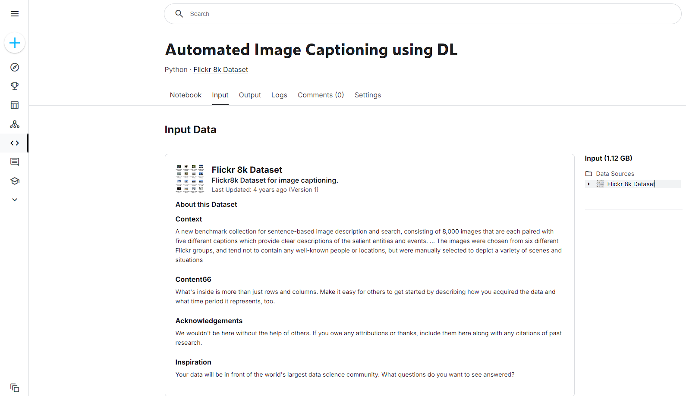
METHODOLOGY
Feature Extraction:
Use VGG16 pre-trained on ImageNet to extract visual features.
Caption Generation:
Input features into LSTM network with Bahdanau Attention.
Dynamically adjust focus using attention weights.
Training and Testing:
Flickr 8k dataset: Images paired with human-generated captions.

Slide 6
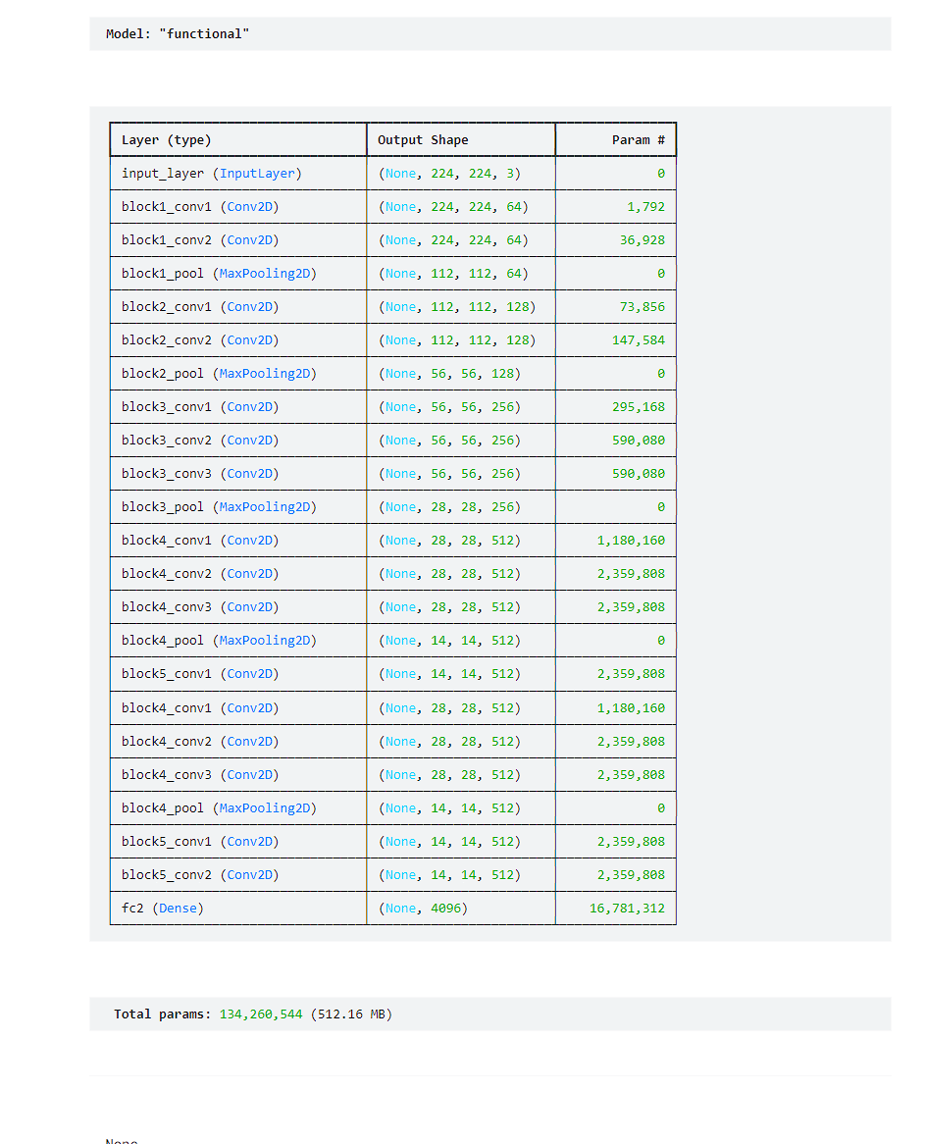
ROLE OF VGG16
Pre-trained CNN model for image feature extraction.
Processes images into rich, abstract feature vectors.
Outputs critical information such as shapes, textures, and object details.
Serves as input for the captioning model.

Slide 7
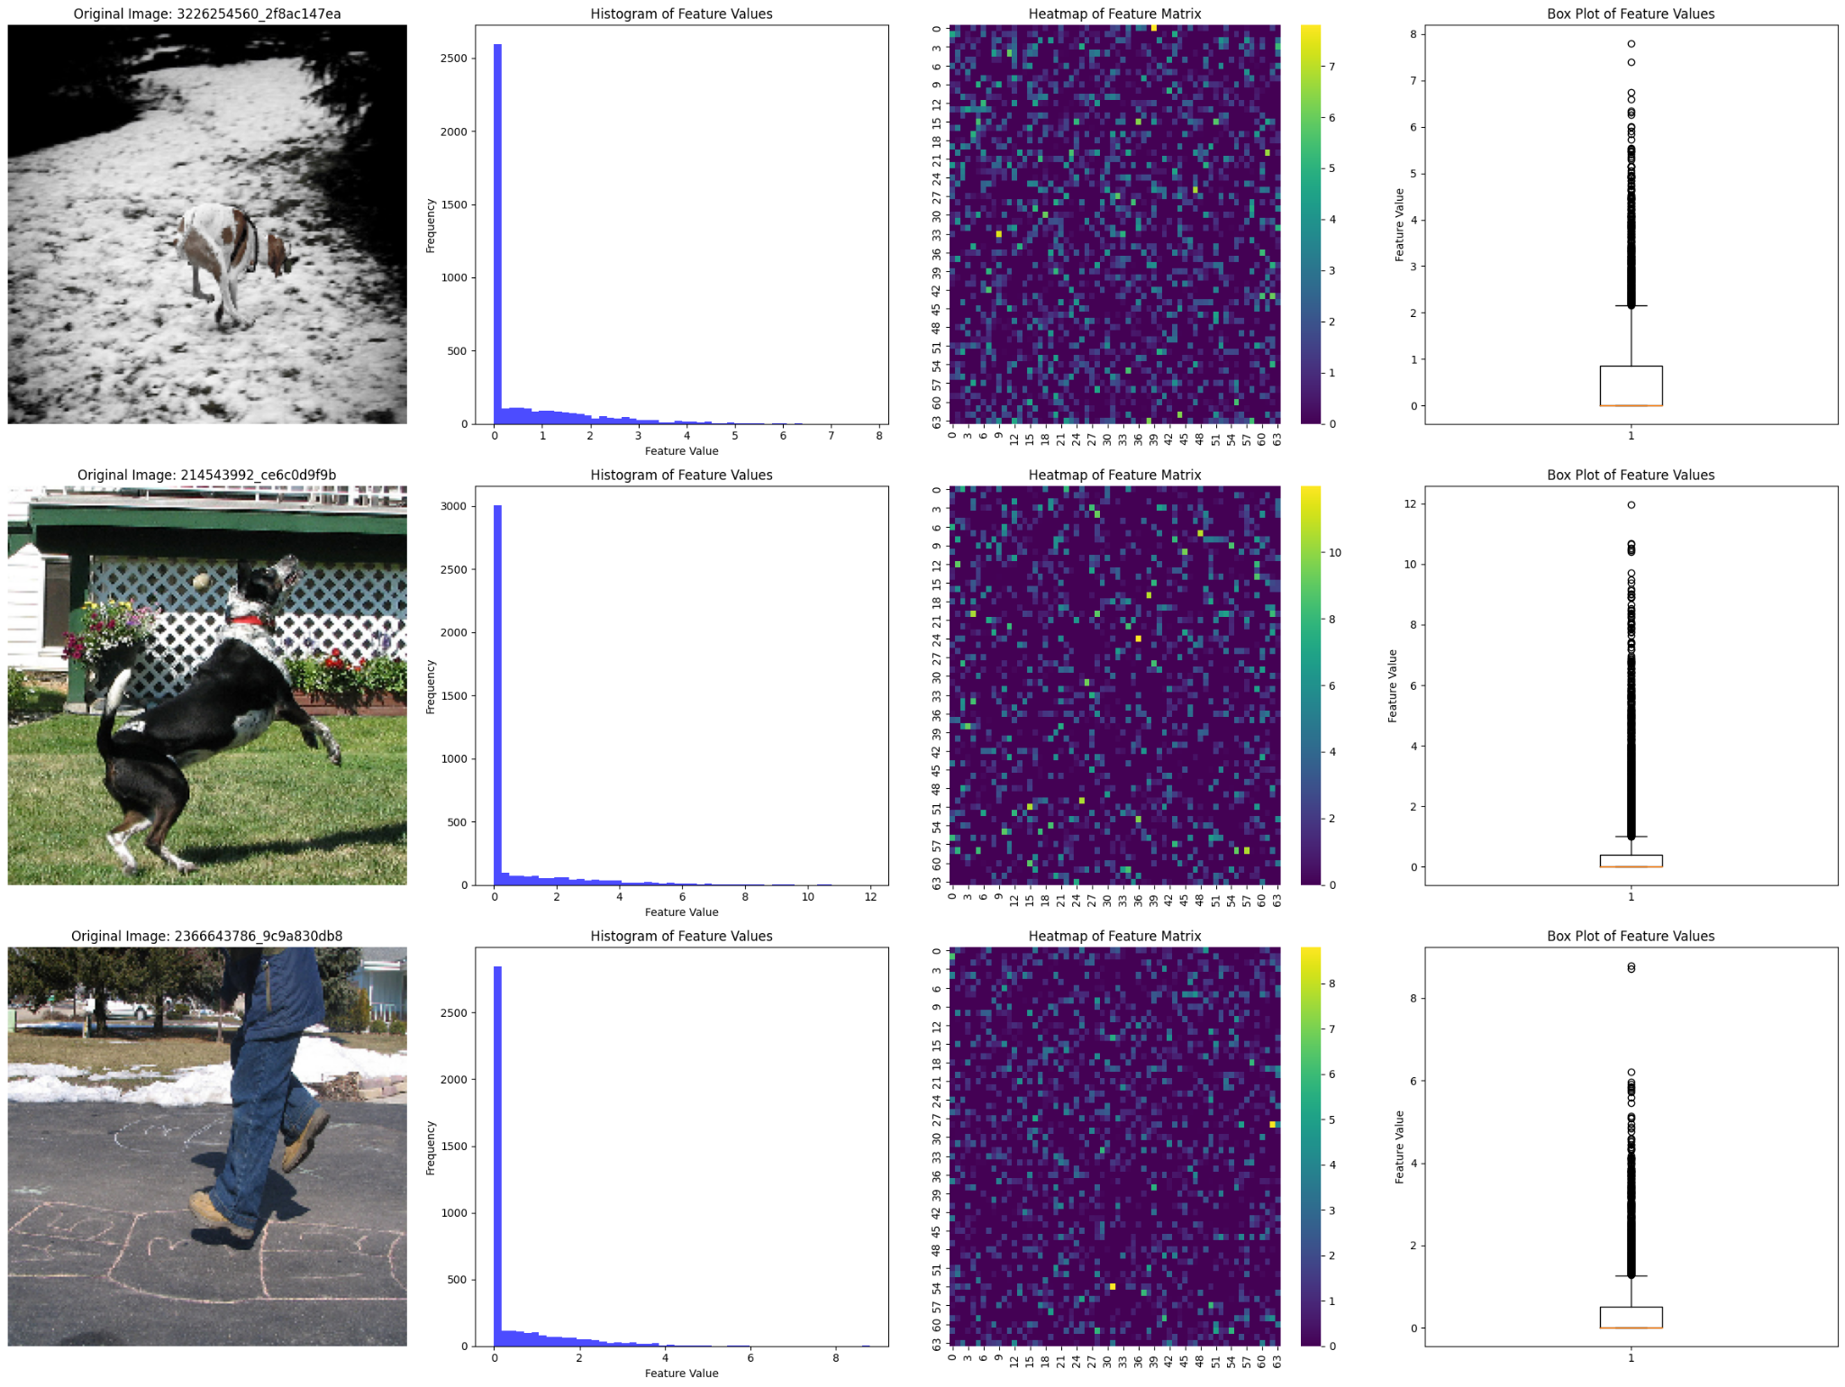
Features Extracted using VGG16 after preprocessing of Images.

Slide 8
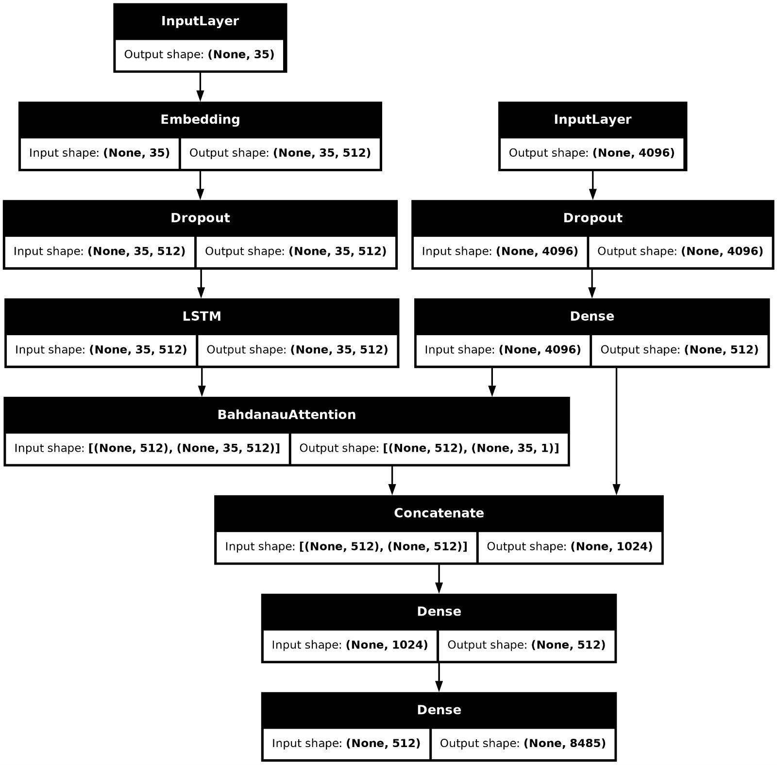
ROLE OF BAHDANU ATTENTION
Dynamically focuses on specific parts of the image during caption generation.
Ensures relevant image regions are emphasized at each step.
Results in detailed and contextually accurate captions.
Handles complex scenes with multiple objects.

Slide 9
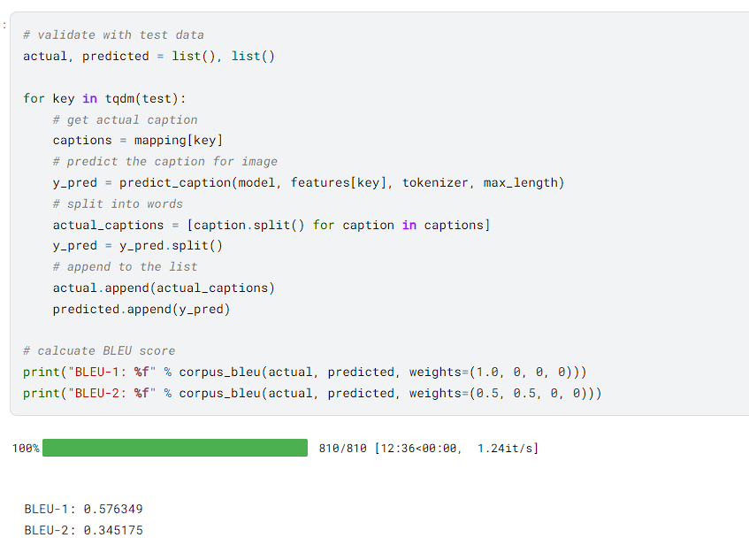
RESULTS
Successfully generates accurate captions for various images.
Attention mechanism improves caption relevance and detail.
Demonstrates the ability to handle diverse and complex scenes.

Slide 10
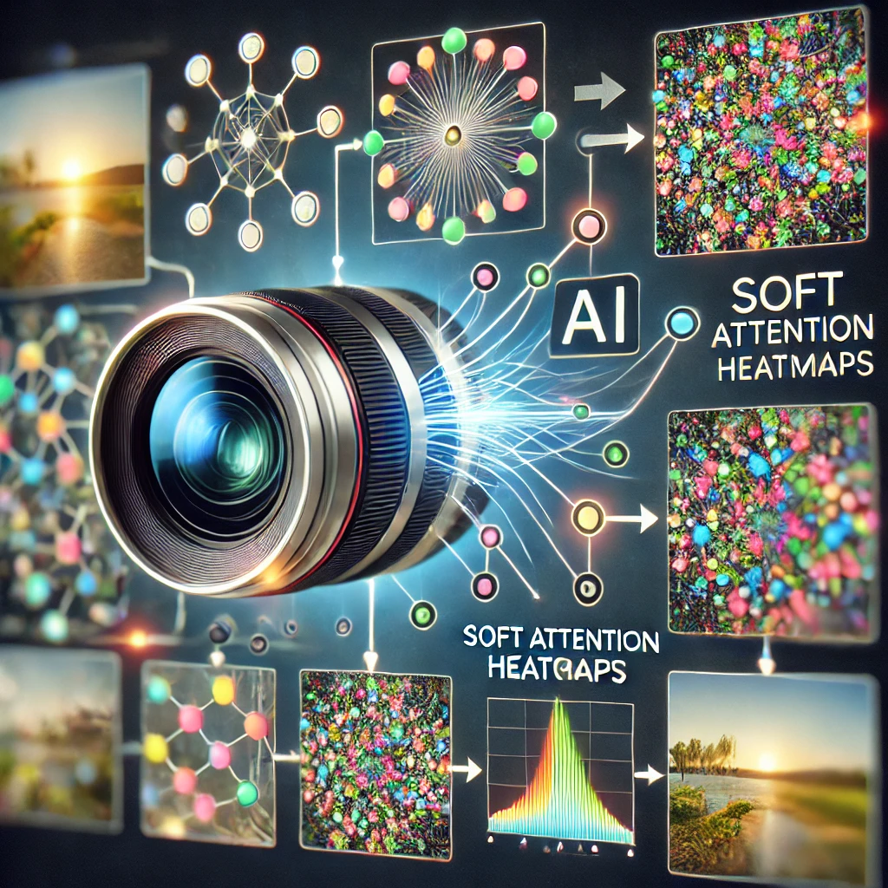
THANK YOU!!
BY -
ANIRUDH SHUKLA
00619011921
AIDS_B1_A
2021-2025

